Slide 1


Intro to Data Science
#1 rated Coding and Data Science Program in all of Orange County, Los Angeles, and the Inland Empire.
Prep Course Introduction - Python

Slide 2


Why Python?
Python is a scripting language; that can be used to create projects from front-end to back-end and machine learning.
Python is open source language.
Python has an great community that you can learn from and contribute to.
Python has a great machine learning library that is very helpful in delivering data science projects

Slide 3
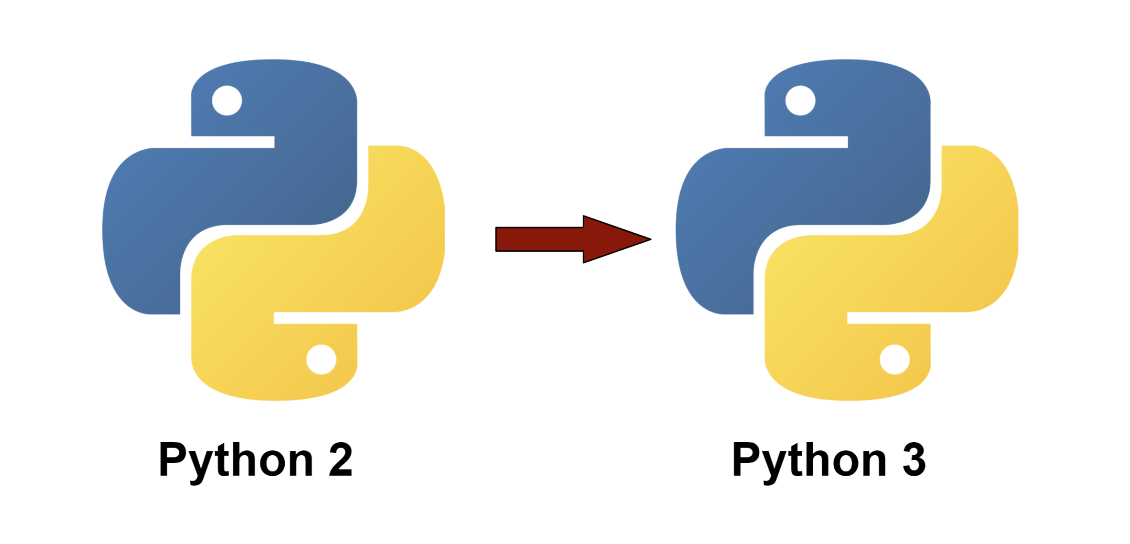
Introductions

Slide 4
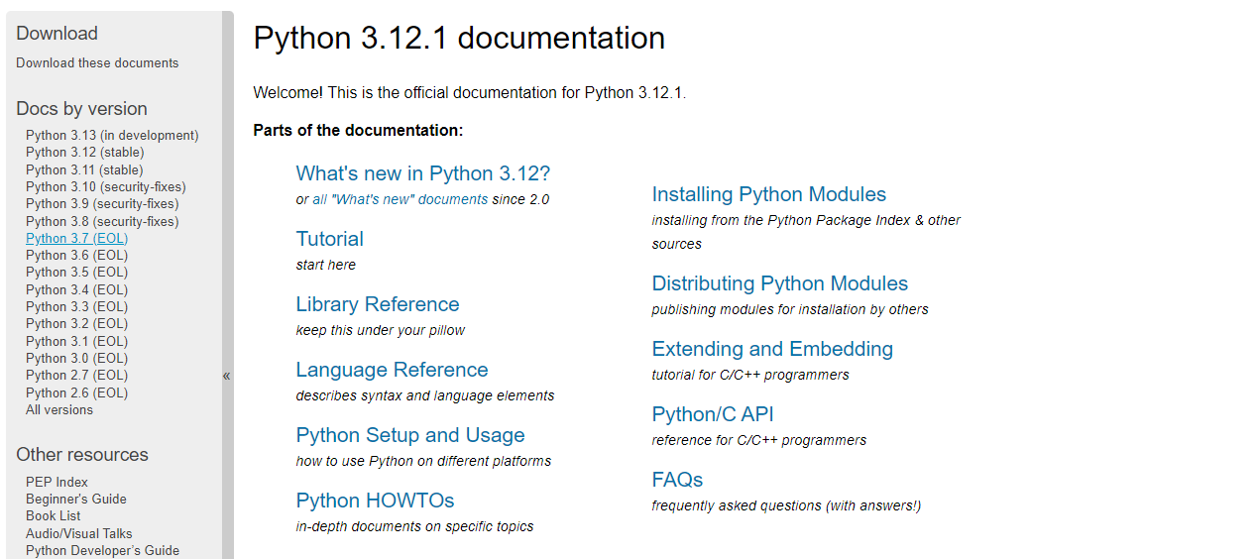
Introductions
https://docs.python.org/3/

Slide 5
Python Control Flow
Python executes code in a top-down order. A program can take different decisions based on different situations, using control flow statements.
If Statements
Try & Except Statements
For Loop Statements
While Statements
Break & Continue Statements

Slide 6
Introductions
https://docs.python.org/3.10/
Read up through chapter 4 of the official Python tutorial:
https://docs.python.org/3.10/tutorial/index.html

Slide 7
Conditionals
if / elif / else

Slide 8
Conditionals
Create a variable named age that contains the age of a person as an integer value:
If the person is less than 2 years old, print a message that the person is a baby.
If the person is at least 2 years old but less than 4, print a message that the person is a toddler.
If the person is at least 4 years old but less than 13, print a message that the person is a kid.
If the person is at least 13 years old but less than 20, print a message that the person is a teenager.
If the person is at least 20 years old but less than 65, print a message that the person is an adult.

Slide 9
Conditionals
Exercise
Given an integer, perform the following conditional actions:
if integer is odd, print Weird
if integer is even and in the inclusive range, print Not Weird
if integer is even and greater than 100, print Weird
integer range:
1 <= integer <= 100

Slide 10
input
Exercise :
Write code that prompts to input two numbers.
Add them together and print the result.

Slide 11
Introductions
https://docs.python.org/3.9/
Read chapter 5 of the official Python tutorial:
https://docs.python.org/3/tutorial/datastructures.html

Slide 12
Python Data Structures
Python data structures
1. Lists
2. Tuples
3. Dictionary
4. Sets

Slide 13
List
A list is a mutable data structure which holds a sequence of items in a specific order.
Square brackets [ ] are used for a list.
Add, remove, changed or search items in the list.
The items in the list can be of any type, including other data structures. Numbers, strings, lists, tuples, dictionaries, and sets can all be included in a list.
Duplicated items are allowed.

Slide 14
List
Exercise :
city = [“Vancouver”, “Irvine”,”Houston”,”Toronto”, “Newport”]
Add a city to the list (LA)
Use sorted() to print your list in alphabetical order without modifying the actual list and show that your list is still in its original order by printing it.
Use sorted() to print your list in reverse alphabetical order without changing the order of the original list.
Use reverse() to change the order of your list. Print the list to show that its order has changed.
Use reverse() to change the order of your list again.
Use sort() to change your list so it’s stored in alphabetical order

Slide 15
Looping
Exercise :
cars = []
Create an empty list cars
Ask the user to append three car manufactures
Add Audi at index [0] in cars list
Remove the last car manufacturer from the list
Remove Audi from the list by name
Use a for loop to print each manufacturer along with its location within list

Slide 16
Looping
for loop
Exercise :
cars = ['Tesla','Ferrari','McLaren']
Think of three car manufacturers, store the names of these manufacturers in a list called cars, and then use a for loop to print out the name of each manufacturer.
Modify your program to print a model from each manufacturer
Add a line at the end of your program stating which one is an electric car manufacturer

Slide 17
Tuple
A tuple is an immutable data structure similar to a list, but with less functionality.
Parenthesis () are used for a tuple.
A tuple can be represented by a series of items
A single element tuple has a trailing , (4,)

Slide 18
tuple
Exercise :
buffet = ('Chicken','Beef','Shrimp','Fries','Salad')
Use a for loop to print each food the restaurant offers.
Try to modify one of the items, and make sure that Python rejects the change.
The restaurant changes its menu, replacing two of the items with different foods. Add a block of code that rewrites the tuple, and then use a for loop to print each of the items on the revised menu.

Slide 19
Looping
Combines the elements of two lists if they are not equal:
x = [1,2,3]
y = [3,1,3]

Slide 20
Looping
while Loop

Slide 21
Looping
Exercise :
Write a loop that prompts the user to enter a series of pizza toppings until they enter a 'quit' value. As they enter each topping, print a message saying you’ll add that topping to their pizza.
Use a break statement to exit the loop when the user enters a 'quit' value.
Maximum of 4 toppings allowed

Slide 22
Dictionary
A dictionary is a way to store key / value pairs. It is a collection which is unordered, changeable and indexed.
Dictionaries are commonly used to store multiple details about a piece of data.
Dictionary notation uses curly brackets, the key-value pairs are separated by a colon, and the pairs are separated by commas.

Slide 23
Dictionary
Dictionary
{'fname': 'Zia', 'lname': 'Khan', 'city': 'Vancouver',}

Slide 24
Dictionary
Exercise :
Use a dictionary to store information about a person you know. Store their first name, last name, and the city in which they live. You should have keys such as first_name, last_name, and city. Print each piece of information stored in your dictionary.
Loop through all the Keys in a Dictionary
Add a cell phone number to the dictionary

Slide 25
Dictionary
Exercise :
Make three new dictionaries representing different people, and store all three dictionaries in a list called people. Loop through your list of people. As you loop through the list, print everything you know about each person.

Slide 26
Functions Exercise
# Combines the elements of two lists if they are not equal:
x = [1,2,3]
y = [3,1,4]

Slide 27
Dictionary
Exercise :
Write a loop that prompts the user to enter a series of pizza toppings until they enter a 'quit' value. As they enter each topping, print a message saying you’ll add that topping to their pizza.
Use a break statement to exit the loop when the user enters a 'quit' value.
Maximum of 4 toppings allowed

Slide 28
Set
Sets are unordered collections of simple objects and are used when the existence of an object in a collection is more important than the order or how many times it occurs.
Using sets you can test for membership,
Intersection,
Union
Difference
Sets do not allow duplicates

Slide 29
Set
Exercise:
basket1 = {'apple', 'orange', 'pear', ‘broccoli’}
basket2 = {‘lettuce’, ‘carrot’, ‘broccoli’, ‘apple’, ‘orange’}
Create a new set with all of the items from both sets
Create a new set with only the items the two sets have in common
Create a new set with only the items the two sets do NOT have in common

Slide 30
Python statements
Assignment
print
if/elif/else
for/else
while/else
pass
a, b = 'good', 'bad'
print('Python')
if "python" in text:
print(text)
for x in mylist:
print(x)
while X > Y:
print('hello')
while True:
pass

Slide 31
Python statements
break
continue
def
return
yield
global
while True:
if exittest(): break
while True:
if skiptest(): continue
def f(a, b, c=1, *d):
print(a+b+c+d[0])
def f(a, b, c=1, *d):
return a+b+c+d[0]
def gen(n):
for i in n: yield i*2
def function():
global x

Slide 32
Python statements
import
from
class
try/except
With
del
import sys
from sys import stdin
class Subclass(Superclass):
x = []
def method(self): pass
try:
action()
except:
print('action error')
with open('data') as myfile:
process(myfile)
del variable

